Slide 1
Smart Question

Slide 2
Table of contents
01
02
03
04
05
06
When to ask smart questions?
What is smart question ?
Avoid when asking smart questions
Why are smart questions important?
How to ask smart questions on your work
Example in work

Slide 3
01 What is smart question
- A smart question is a type of question asked with the goal of optimizing information gathering or stimulating creative thinking.
- These questions are often designed to explore, confront a problem, or create a deeper understanding of a specific topic.
Signs this is a smart question
The question is details and clarity
Its make thought Stimulation
Context Relevance
The question is multidimensionality and enhancement
Promote Discussion
The question is unique and new

Slide 4
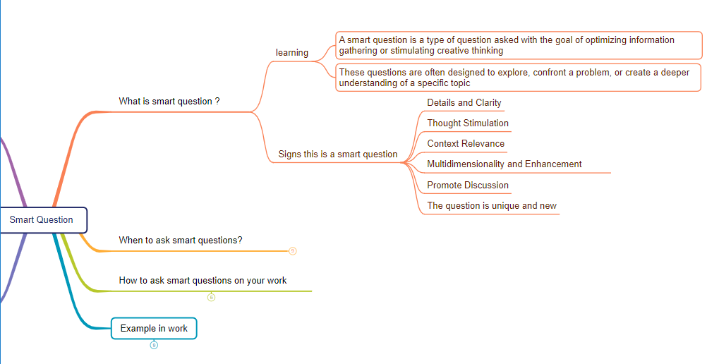
01 What is smart question

Slide 5
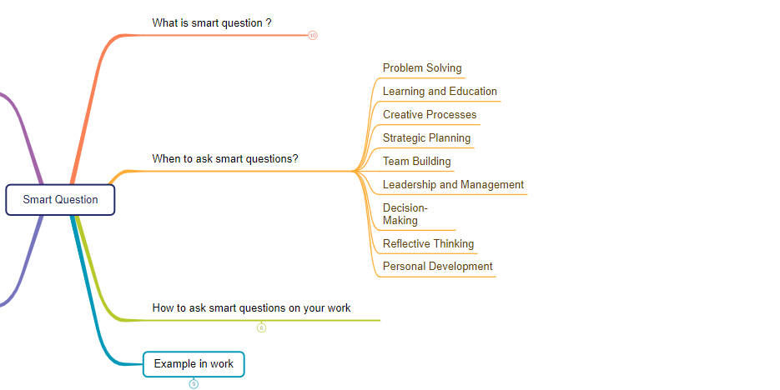
02 When to ask smart questions?

Slide 6
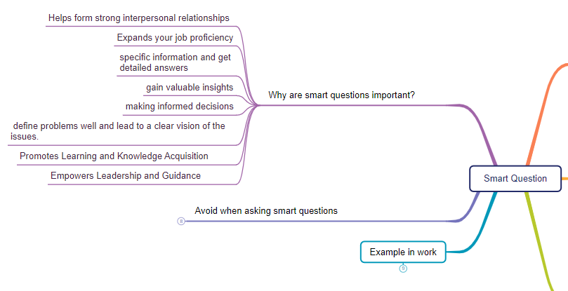
03 Why are smart questions important?

Slide 7
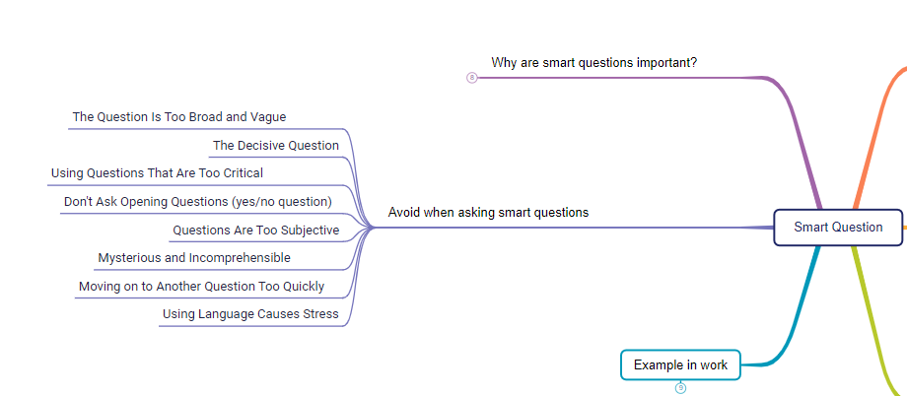
04 Avoid when asking smart questions?

Slide 8
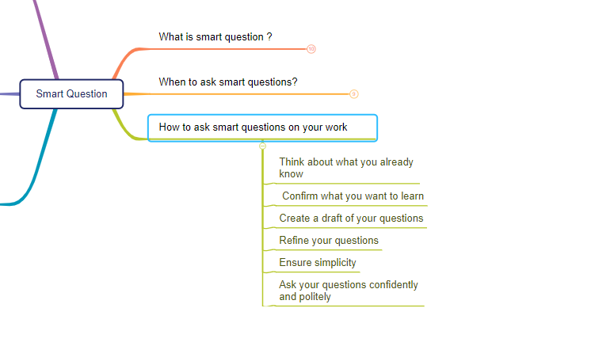
05 How to ask smart questions on your work ?

Slide 9
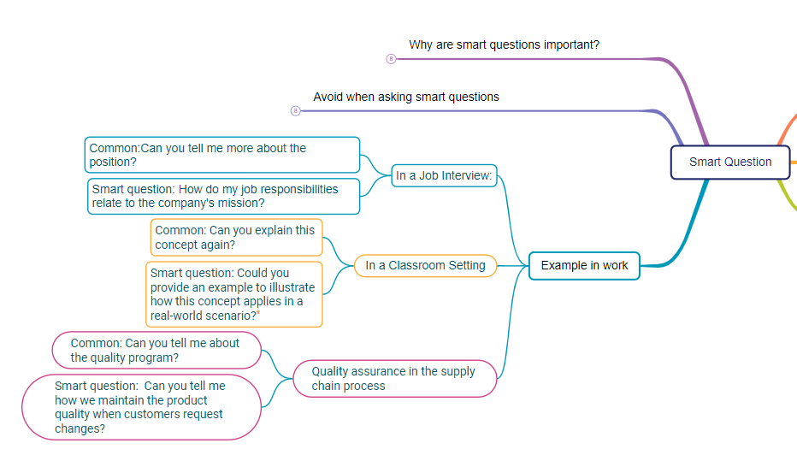
06 Example in work

Slide 10
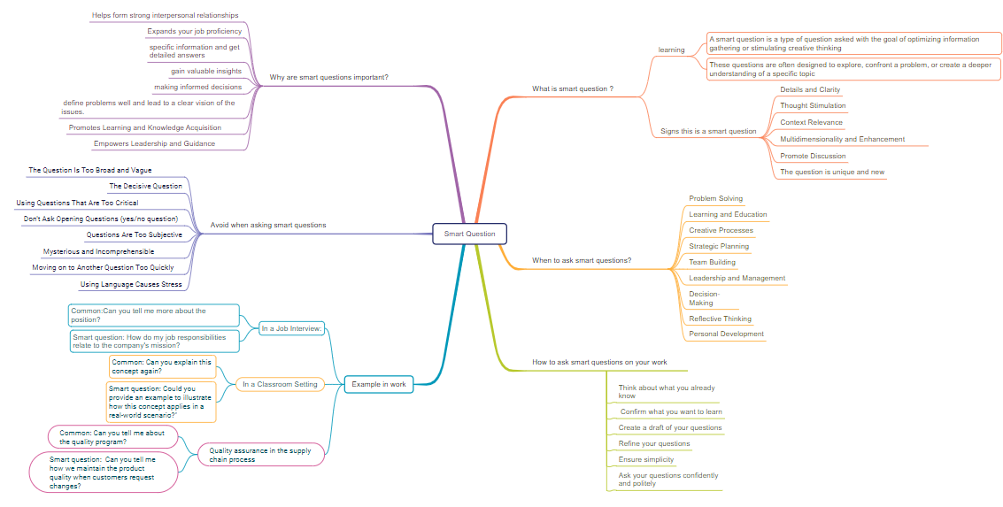
Conclusion

Slide 11

Thanks!
Please keep this slide for attribution

